Slide 1
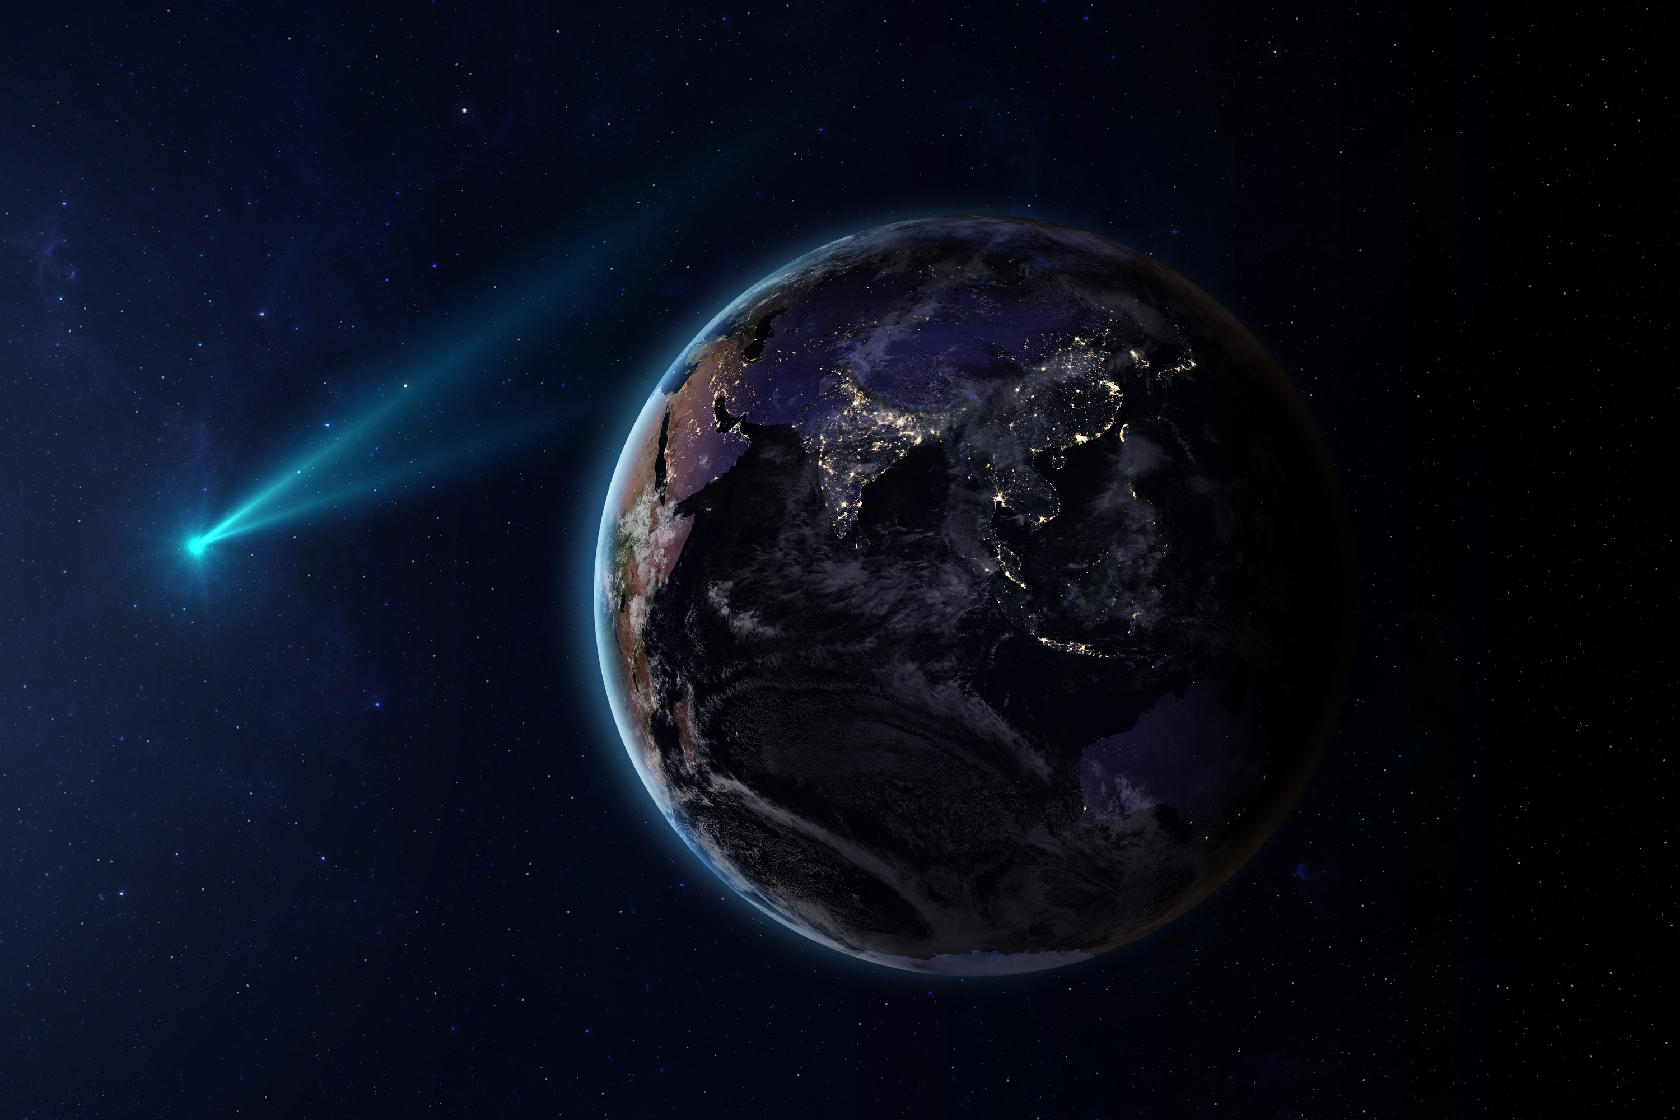

Home
About
Contact
0xN3m3sis
Build a Space Biology Knowledge Engine
Date & Time
20 : 45
ai.termnh.com
4 / 10 / 2025

Slide 2






0xN3m3sis
Home
About
Contact
The problem
statement

Slide 3



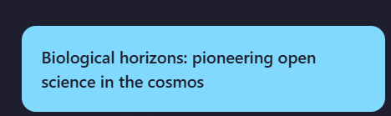

0xN3m3sis
Home
About
Contact
Solution with web
01
01.
Key words
02.
Filters
03.
Related Topics
04.
Summarizing

Slide 4

0xN3m3sis
Home
About
Contact
Why us ?
Concise
Efficient
Accessible

Slide 5
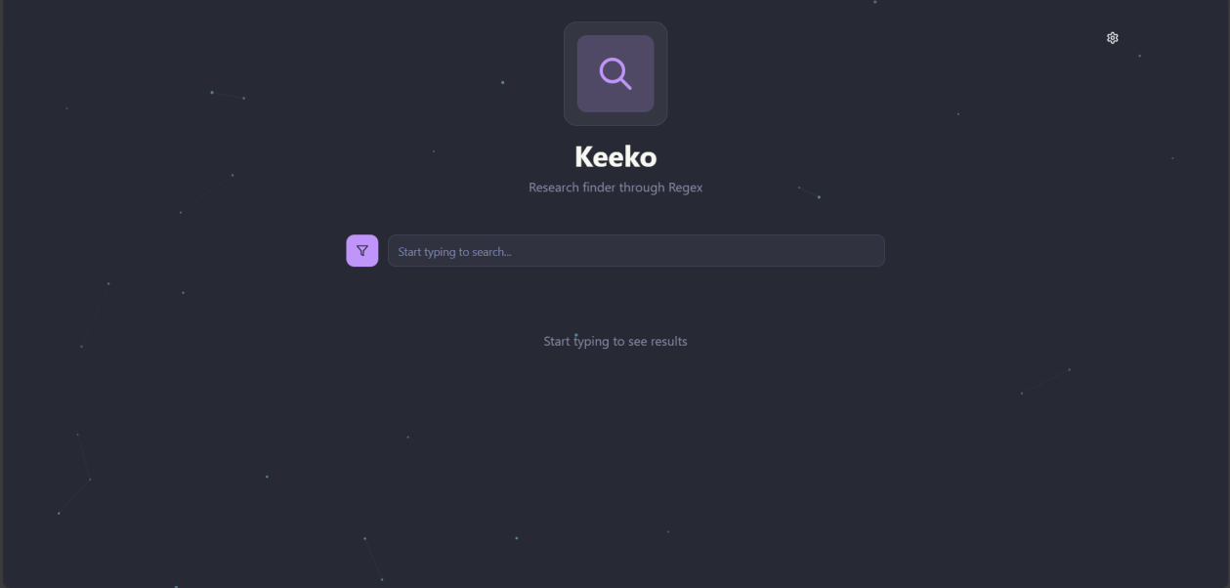


0xN3m3sis
Home
About
Contact

Slide 6
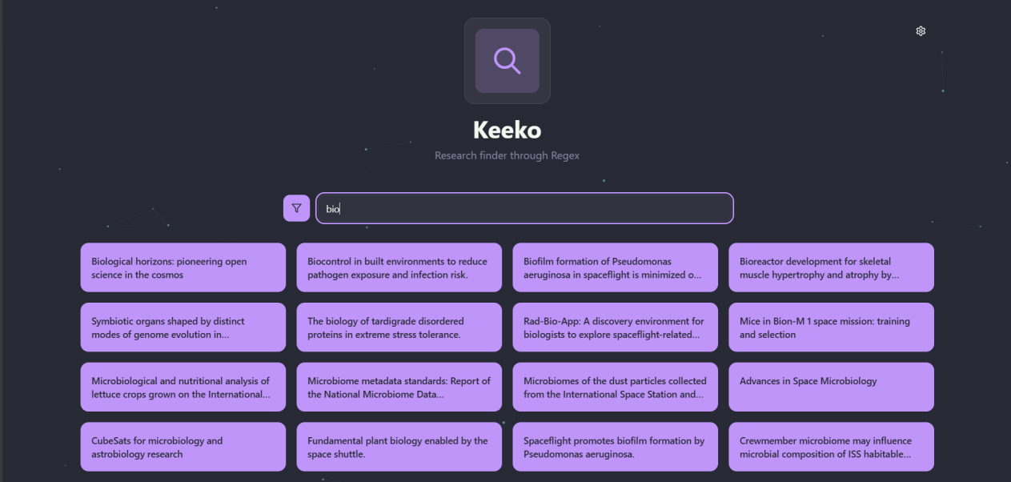
0xN3m3sis
Home
About
Contact

Slide 7
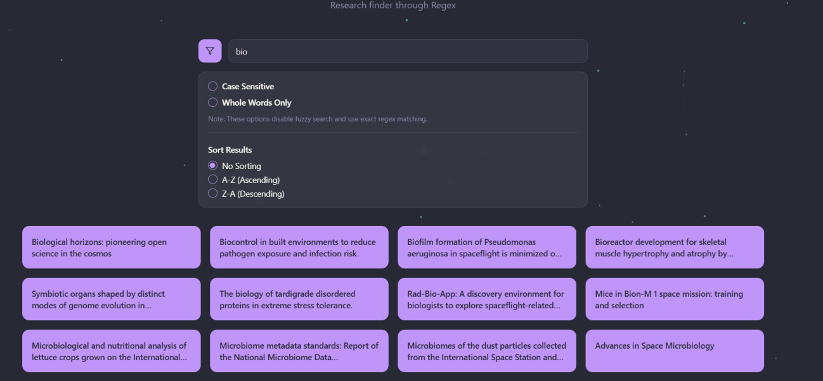
0xN3m3sis
Home
About
Contact

Slide 8
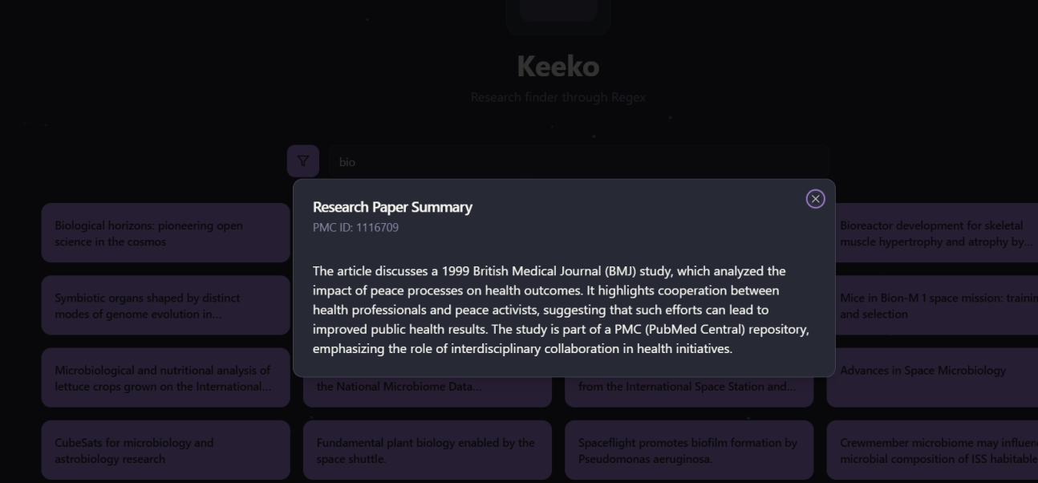
0xN3m3sis
Home
About
Contact

Slide 9
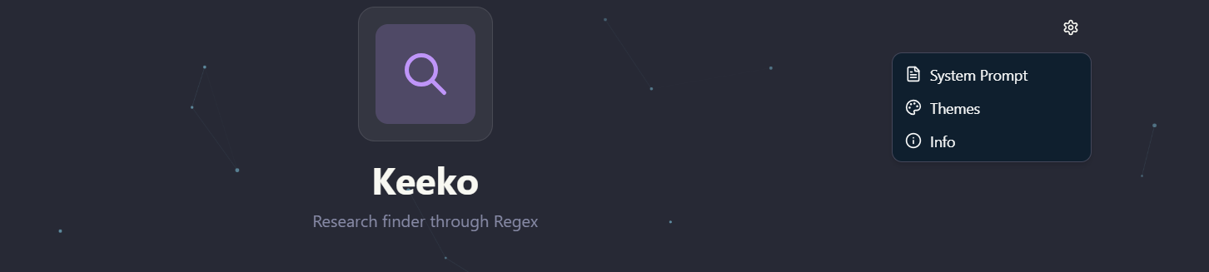
0xN3m3sis
Home
About
Contact

Slide 10
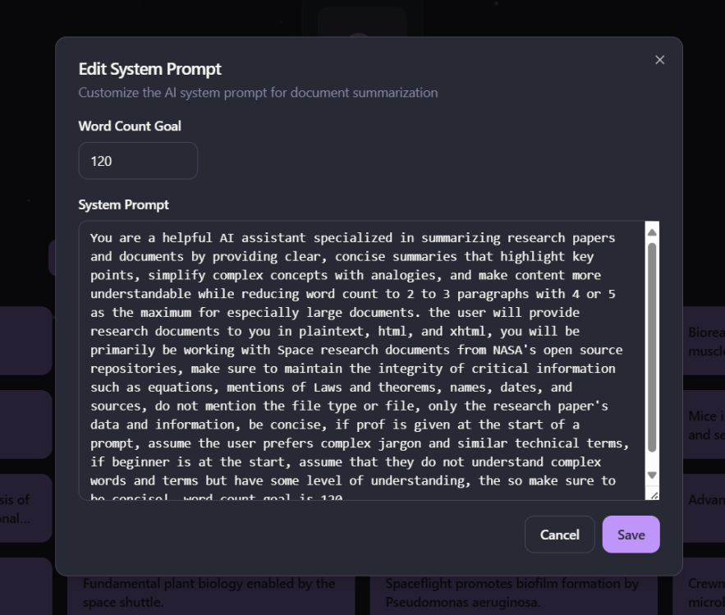
0xN3m3sis
Home
About
Contact

Slide 11
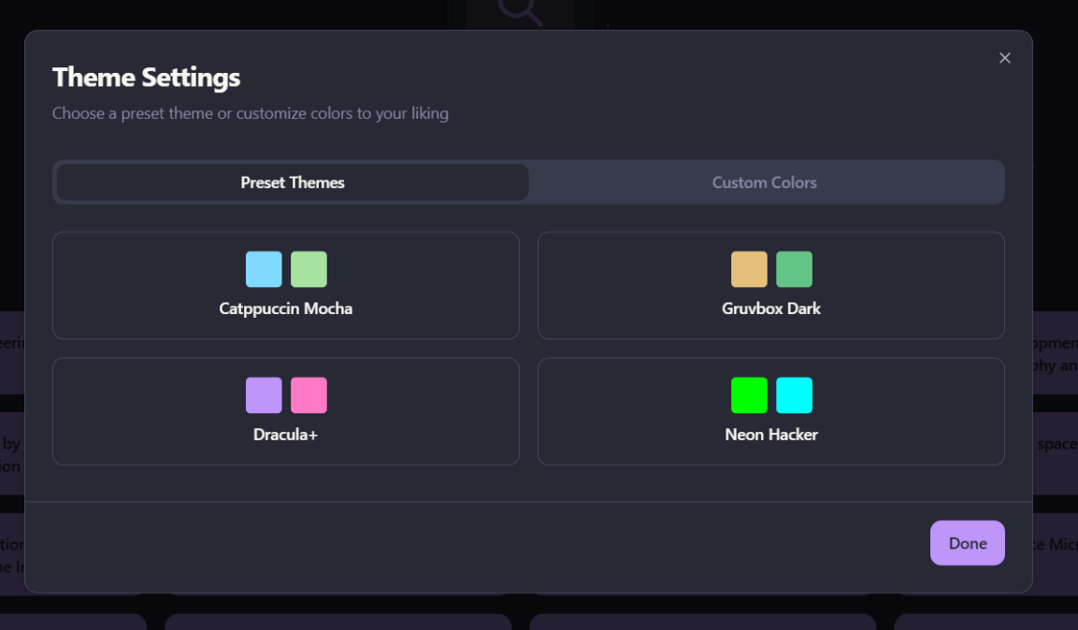
0xN3m3sis
Home
About
Contact

Slide 12

0xN3m3sis
Home
About
Contact

Slide 13

0xN3m3sis
Home
About
Contact
Future vision

Slide 14

0xN3m3sis
Home
About
Contact
Q&A
Session

Slide 15

Home
About
Contact
0xN3m3sis
Build a Space Biology Knowledge Engine
Date & Time
20 : 52
4 / 10 / 2025
Thank You for Attention

